Slide 1
A LIP SYNC EXPERT IS ALL YOU NEED FOR SPEECH TO LIP GENERATION IN THE YOUTUBE

Slide 2
ABSTRACT
In This Work, We Investigate The Problem Of Lip-syncing A Talking Face Video Of An Arbitrary Identity To Match A Target Speech Segment. Current Works Excel At Producing Accurate Lip Movements On A Static Image Or Videos Of Specific People Seen During The Training Phase.
However, They Fail To Accurately Morph The Lip Movements Of Arbitrary Identities In Dynamic, Unconstrained Talking Face Videos, Resulting In Significant Parts Of The Video Being Out-of-sync With The New Audio.
We Identify Key Reasons Pertaining To This And Hence Resolve Them By Learning From A Powerful Lip-sync Discriminator.
Next, We Propose New, Rigorous Evaluation Benchmarks And Metrics To Accurately Measure Lip Synchronization In Unconstrained Videos.
Extensive Quantitative Evaluations On Our Challenging Benchmarks Show That The Lip-sync Accuracy Of The Videos Generated By Our Wav2lip Model Is Almost As Good As Real Synced Videos.
We Provide A Demo Video Clearly Showing The Substantial Impact Of Our Wav2lip Model And Evaluation.

Slide 3
EXISTING SYSTEM
Firstly, learn the lyrics to a song of your choice
• Secondly, set up camera to record so your face is in full view.
• Finally, record the lip sync in time with the correct timing.

Slide 4
PROPOSED SYSTEM
Video to use the wav2lip model algorithm technique with auto sync the lip mouth to recognize the amplitude level to sync the video and audio in any type of application.

Slide 5
Back Story
Although the model works well without having any real videos of the subject, as comparing the variations from frame-to-frame as shown in Figure 8. But there would be a challenge in predicting the ‘real’ or ‘fake’ classification without real video for having precise results. The real video of the subject would act as a backbone for the predicted results. The next major limitation is the position of the subject in the video
ADVANTAGES:
The model is heavyweight in terms of computational complexity. The video must be at least 10 seconds for getting decent results, 15-30 seconds would be much better for higher accuracy.
LIMITATION:
This is due to the mismatch of the process for identifying the DeepFakes patterns in videos

Slide 6
LITERATURE SURVEY
S.NO | TITLE | CONTENT | AUTHOR | YEAR
1 | Many-to-Many Unsupervised Speech Conversion From Nonparallel Corpora | In this work, we train a speech conversion model for multiple domains rather than a specific source and target domain pair, and we generate diverse output speech signals from a given source domain speech by transferring some speech style-related characteristics while preserving its linguistic content information. The proposed method comprises a variational autoencoder (VAE)-based many-to-many speech conversion network with a Wasserstein generative adversarial network (WGAN) and a skip-connected autoencoder-based self-supervised learning network. | Yun Kyung Lee; Hyun Woo Kim | 2021

Slide 7
LITERATURE SURVEY
S.NO | TITLE | CONTENT | AUTHOR | YEAR
2 | An Overview of Voice Conversion and Its Challenges: From Statistical Modeling to Deep Learning | Voice conversion involves multiple speech processing techniques, such as speech analysis, spectral conversion, prosody conversion, speaker characterization, and vocoding. With the recent advances in theory and practice, we are now able to produce human-like voice quality with high speaker similarity. In this article, we provide a comprehensive overview of the state-of-the-art of voice conversion techniques and their performance evaluation methods from the statistical approaches to deep learning, and discuss their promise and limitations. We will also report the recent Voice Conversion Challenges (VCC), the performance of the current state of technology, and provide a summary of the available resources for voice conversion research. | Berrak Sisman; Junichi Yamagishi; Simon King | 2020

Slide 8
LITERATURE SURVEY
S.NO | TITLE | CONTENT | AUTHOR | YEAR
3 | An Overview of Voice Conversion and Its Challenges: From Statistical Modeling to Deep Learning | In this paper, a neural network named sequence-to-sequence ConvErsion NeTwork (SCENT) is presented for acoustic modeling in voice conversion. At training stage, a SCENT model is estimated by aligning the feature sequences of source and target speakers implicitly using attention mechanism. At the conversion stage, acoustic features and durations of source utterances are converted simultaneously using the unified acoustic model. Mel-scale spectrograms are adopted as acoustic features, which contain both excitation and vocal tract descriptions of speech signals. The bottleneck features extracted from source speech using an automatic speech recognition model are appended as an auxiliary input. | Jing-Xuan Zhang; Zhen-Hua Ling; Li-Juan Liu | 2019

Slide 9
LITERATURE SURVEY
S.NO | TITLE | CONTENT | AUTHOR | YEAR
4 | Vocal Effort Based Speaking Style Conversion Using Vocoder Features and Parallel Learning | Speaking style conversion (SSC) is the technology of converting natural speech signals from one style to another. In this study, we aim to provide a general SSC system for converting styles with varying vocal effort and focus on normal-to-Lombard conversion as a case study of this problem. We propose a parametric approach that uses a vocoder to extract speech features. These features are mapped using parallel machine learning models from utterances spoken in normal style to the corresponding features of Lombard speech. Finally, the mapped features are converted to a Lombard speech waveform with the vocoder. | Shreyas Seshadri; Lauri Juvela; Okko Räsänen | 2019

Slide 10
LITERATURE SURVEY
S.NO | TITLE | CONTENT | AUTHOR | YEAR
5 | Voice Conversion for Whispered Speech Synthesis | We present an approach to synthesize whisper by applying a handcrafted signal processing recipe and Voice Conversion (VC) techniques to convert normally phonated speech to whispered speech. We investigate using Gaussian Mixture Models (GMM) and Deep Neural Networks (DNN) to model the mapping between acoustic features of normal speech and those of whispered speech. We evaluate naturalness and speaker similarity of the converted whisper on an internal corpus and on the publicly available wTIMIT corpus. | Marius Cotescu; Thomas Drugman; Goeric Huybrechts | 2019

Slide 11
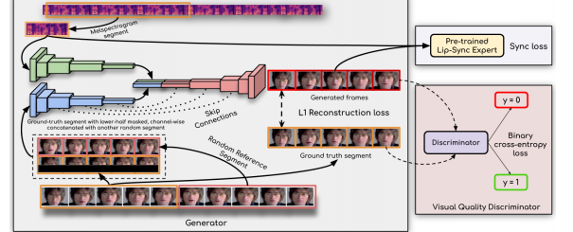
ARCHITECTURE DIAGRAM

Slide 12
ARCHITECTURE DIAGRAM
GENERATED VIDEO
REAL VIDEO
TRAINED VIDEO
First frame
IDENTITY ENCODER
FRAME DECODER
VIDEO L1 RECONSTRUCTION LOSS
GAUSSIAN NOISE
LIP SYNC VIDEO RESULT
INPUT AUDIO
AUDIO SELF SUPERVISED LOSS

Slide 13
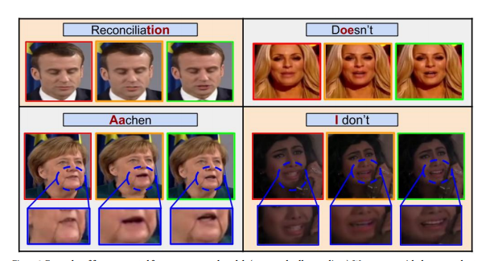

Slide 14
REFERENCES
[1] T. Afouras, J. S. Chung, A. Senior, O. Vinyals, and A. Zisserman. 2018. Deep Audio-Visual Speech Recognition. In arXiv:1809.02108.
[2] T. Afouras, J. S. Chung, and A. Zisserman. 2018. The Conversation: Deep AudioVisual Speech Enhancement. In INTERSPEECH.
[3] Triantafyllos Afouras, Joon Son Chung, and Andrew Zisserman. 2018. LRS3-TED: a large-scale dataset for visual speech recognition. arXiv preprint arXiv:1809.00496 (2018).
[4] Lele Chen, Zhiheng Li, Ross K Maddox, Zhiyao Duan, and Chenliang Xu. 2018. Lip movements generation at a glance. In Proceedings of the European Conference on Computer Vision (ECCV). 520–535.
[5] Lele Chen, Ross K Maddox, Zhiyao Duan, and Chenliang Xu. 2019. Hierarchical cross-modal talking face generation with dynamic pixel-wise loss. In Proceedings of the IEEE Conference on Computer Vision and Pattern Recognition. 7832–7841.
[6] Lele Chen, Haitian Zheng, Ross K Maddox, Zhiyao Duan, and Chenliang Xu. 2019. Sound to Visual: Hierarchical Cross-Modal Talking Face Video Generation. In IEEE Computer Society Conference on Computer Vision and Pattern Recognition workshops

